Slide 1
DS 3, Polder 35/3- 6 March 2023
Country and riverside slope protection eroding at edges
flap gate and lift gate closed, water leakage at right side lift gate
Rusting
Water level gauges submerged and not visible

Slide 2
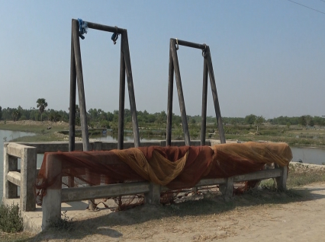
Overview

Slide 3
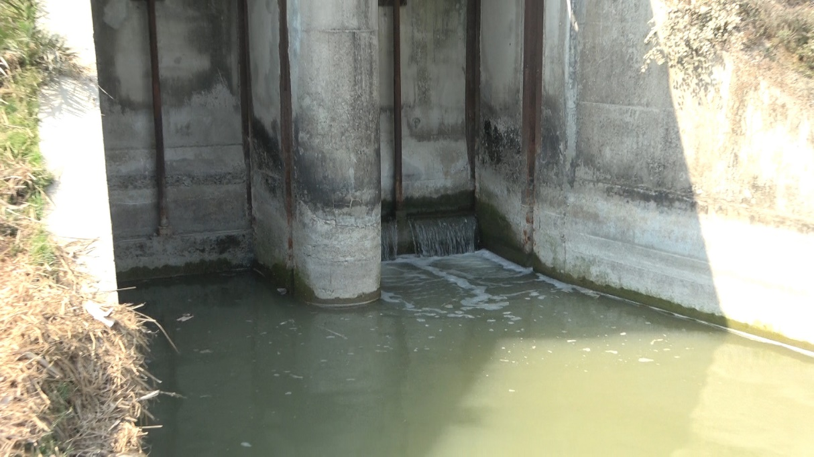
Country Side Lift Gate

Slide 4
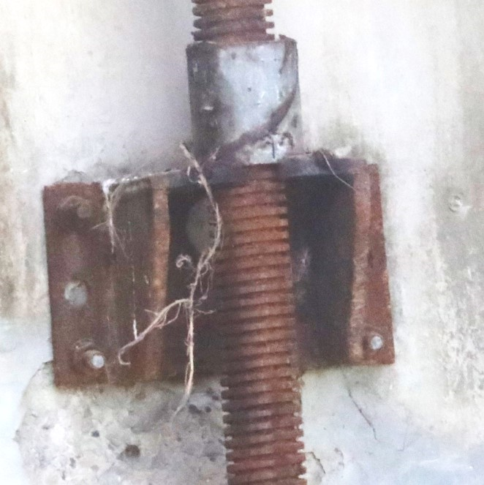
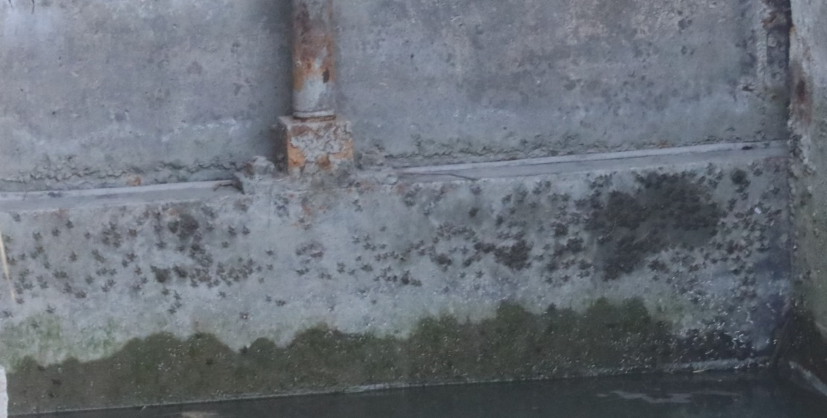

Slide 5
Country Side Slope Protection

Slide 6
Riverside Slope Protection

Slide 7
Overalll Assessment
Assessment Criteria | Findings – DS 3
Design compliance of the mechanical works | Complying
Functionality of the flap gate assemblies | Closed, hoisting assembly is absent
Functionality of the lift gate assemblies | Closed, one gate leaking, wheels are absent
Preventive maintenance requirements
Rust prevention / painting | Severely rusting
Status of neoprene rubber seal | Not visible
Status of nuts and bolts | Rusting, partly embedded in concrete
Status / functionality of other parts | Water level gauge not visible
Status / maintenance requirements of r/s and c/s wing walls | Wing walls overflown, backfill material missing
Status / maintenance requirements of r/s and c/s slope protection, and | Edges of slope protection eroding
Overall assessment | Partly operational, maintenance works required

